Slide 1
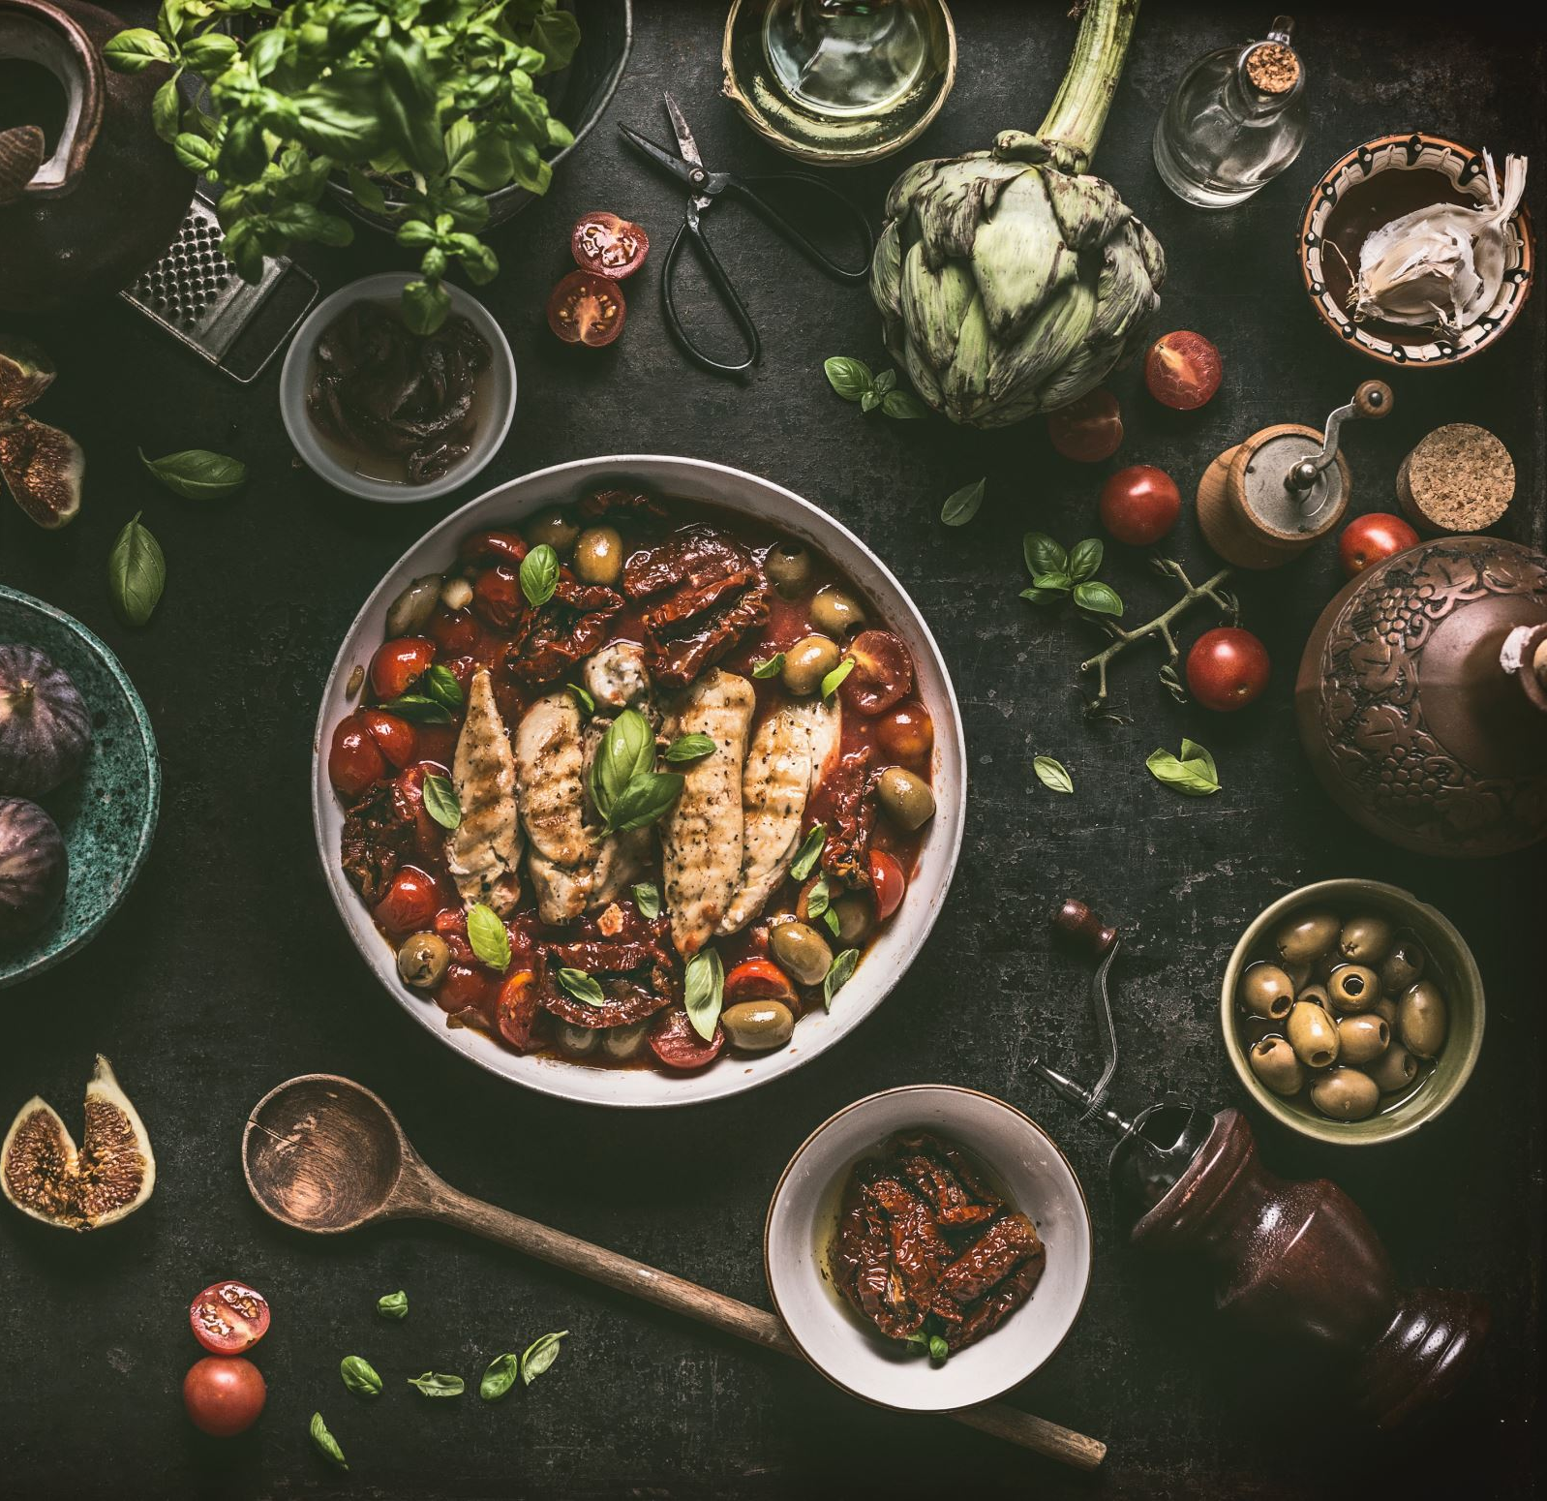
One (Healthy) Recipe to Rule them All
Group 4
Alyssa Hondrade
Lakna Premasinghe

Slide 2
Scope
Background
Research Questions
Project Scope
Data Exploration and Cleaning
Data Analysis and Visualisation

Slide 3
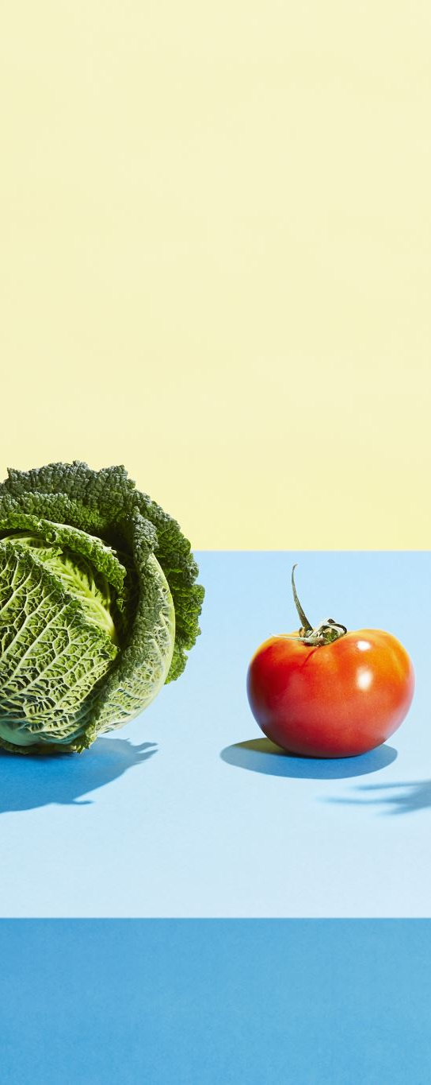
Background
94% of Australian adults do not meet the daily recommendations for fruit and vegetable consumption.
Notes:
Our group was interested in a topic in the healthcare field, with an application that is easily relatable and one that would not require too much research understanding the context, given the project time constraints.
We landed on the idea of nutrition and food, because who doesn’t love to eat delicious food?
We explored Australian nutrition and discovered that according to the 2021 National Health Survey, 94% of Australian adults do not meet the daily recommendations for fruit and vegetable consumption.
The goal, as per the project proposal, is to compare recipes from two popular recipe websites, Spoonacular and Food.com, and identify “healthy” recipes using two market-implemented measures: Nutri-Scores and Weight Watchers Smart Points.

Slide 4
Research Questions
Popularity vs Health Rating
Are more popular recipes healthier?
What is the health rating of the most popular recipes?
Meal Types
What meal type (breakfast, lunch, or dinner) is the healthiest?
What percentage of recipes are healthy?
What is the most popular ingredient per meal type?
Cuisines
Which cuisine has the healthiest recipes?

Slide 5
Project Scope
Health Measure | Data Source | Meal Type | Cuisine
Nutri-Scores | Spoonacular API | Breakfast | African Cajun Caribbean French German Greek Indian Irish Japanese Korean Mexican Spanish Thai Vietnamese
 |  | Lunch
Weight Watchers Smart Points | Kaggle Dataset
 |  | Dinner
Notes:
Our group was interested in a topic in the healthcare field, with an application that is easily relatable and one that would not require too much research understanding the context, given the project time constraints.
We landed on the idea of nutrition and food, because who doesn’t love to eat delicious food?
We explored Australian nutrition and discovered that according to the 2021 National Health Survey, 94% of Australian adults do not meet the daily recommendations for fruit and vegetable consumption.
The goal of the project is to compare recipes from two popular recipe websites, Spoonacular and Food.com, and identify “healthy” recipes using two market-implemented measures: Nutri-Scores and Weight Watchers Smart Points. In terms of the outcome, the primary dataset we used was Food.com (we’ll talk through the Spoonacular API briefly) and the primary measure of recipe healthiness as “Weight Watchers”, and for context, the lower the points are the healthier the recipe is.
- Nutri-Scores: API was limited to 500 requests per day, and ran out of time.
- Spoonacular API: even after about 20 requests (limited to 150 per day), most rows did not have the minimum data required. Reducing the dataset to a single meal type reduced the dataset from 1600 to 180.

Slide 6
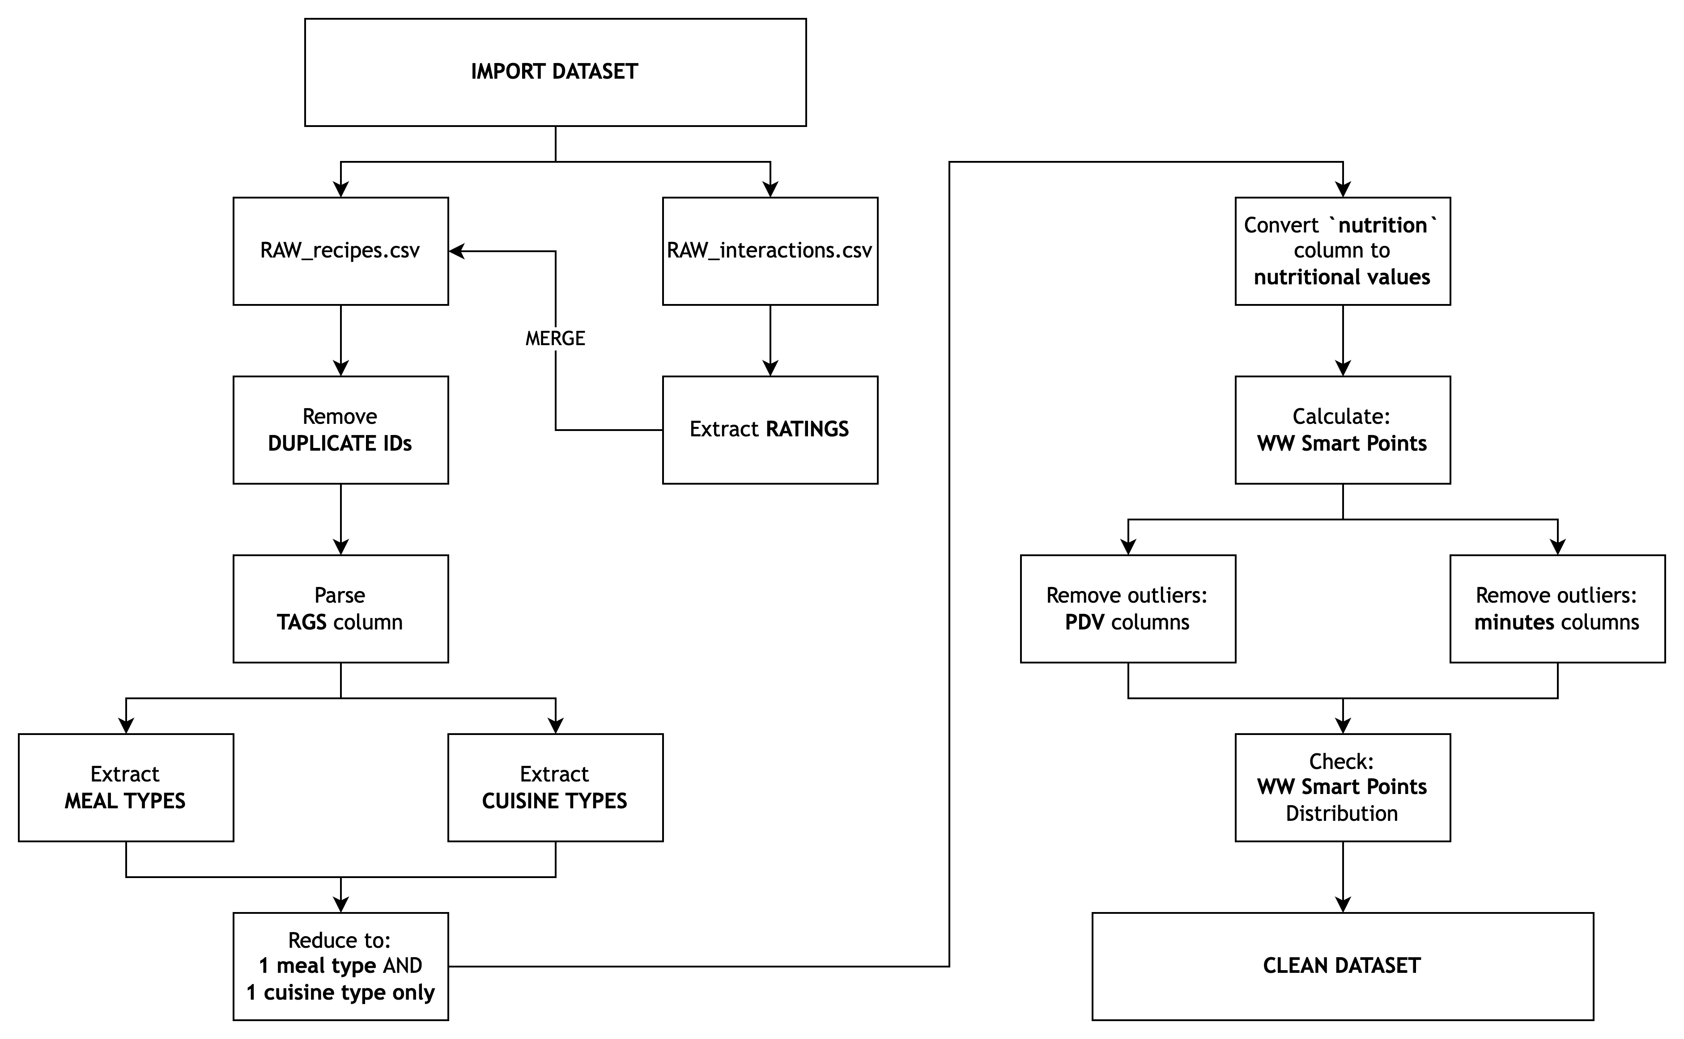
Data Exploration and Cleaning

Slide 7
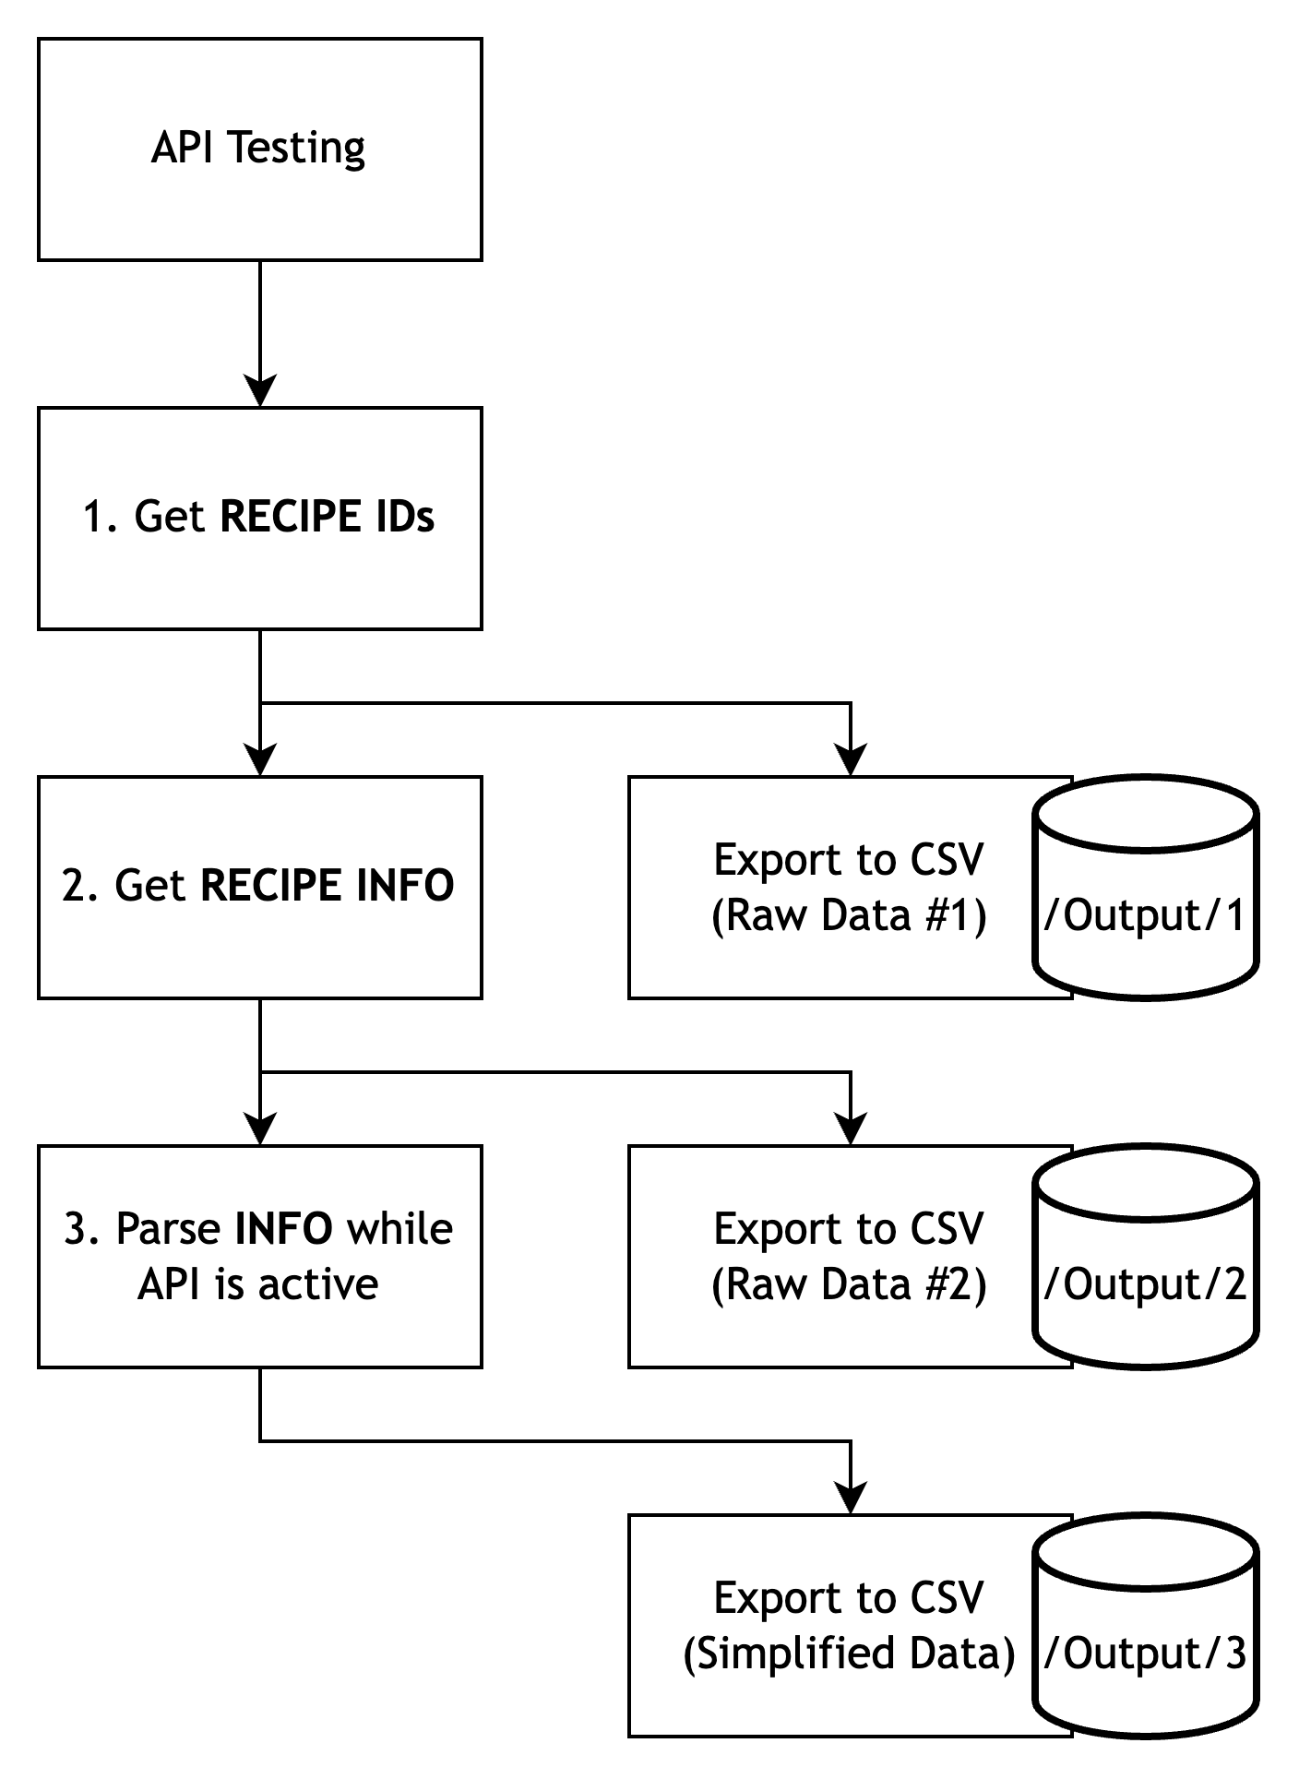
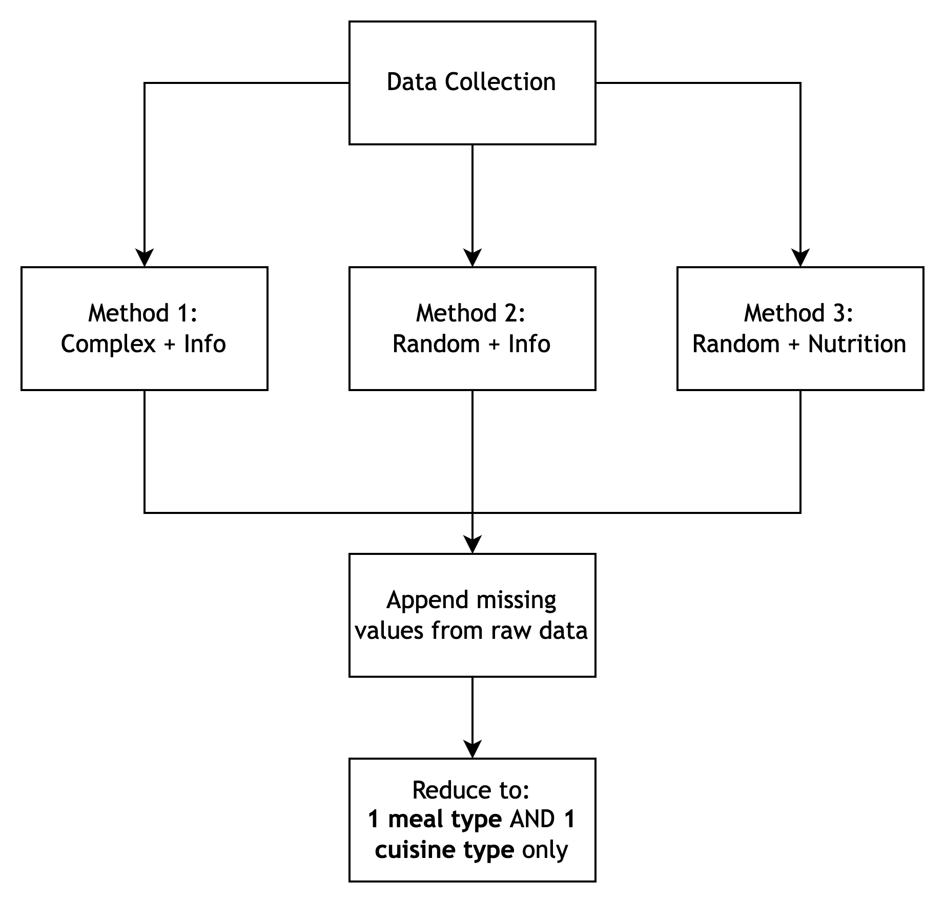
Data Exploration and Cleaning

Slide 8
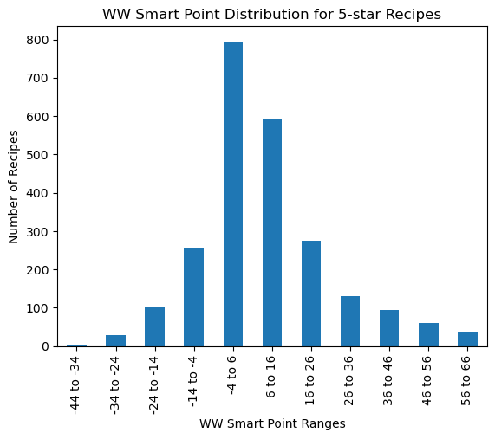
Data Analysis and Visualisation
Popularity vs Health Rating
Are more popular recipes healthier?
What is the health rating of the most popular recipes?

Slide 9
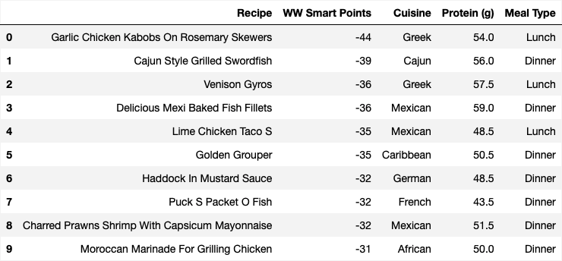
Data Analysis and Visualisation
Popularity vs Health Rating
Are more popular recipes healthier?
What is the health rating of the most popular recipes?

Slide 10
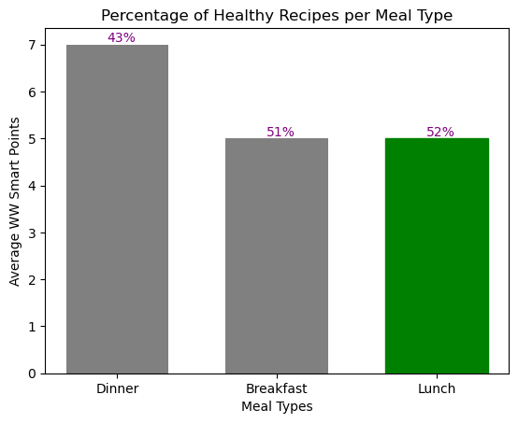
Data Analysis and Visualisation
Meal Types
What meal type (breakfast, lunch, or dinner) is the healthiest?
What percentage of recipes are healthy?
What is the most popular ingredient per meal type?

Slide 11
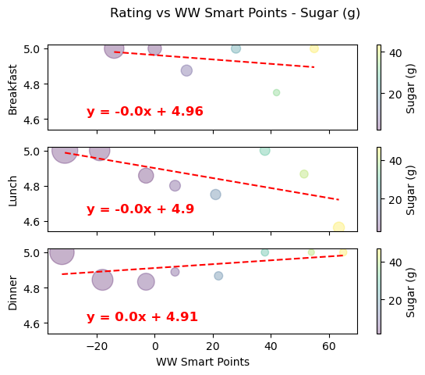
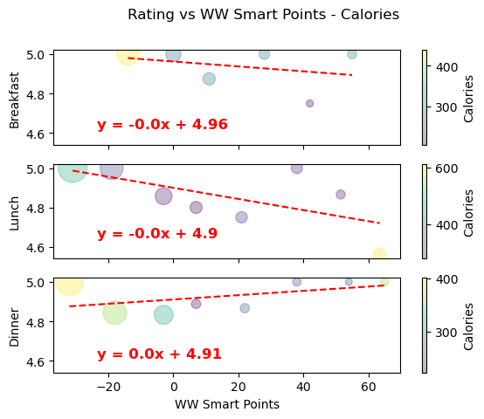
Data Analysis and Visualisation
Meal Types
What meal type (breakfast, lunch, or dinner) is the healthiest?
What percentage of recipes are healthy?
What is the most popular ingredient per meal type?

Slide 12
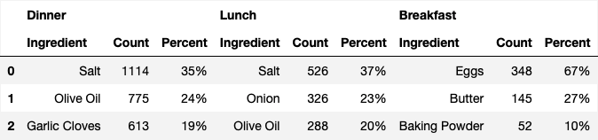
Data Analysis and Visualisation
Meal Types
What meal type (breakfast, lunch, or dinner) is the healthiest?
What percentage of recipes are healthy?
What is the most popular ingredient per meal type?

Slide 13
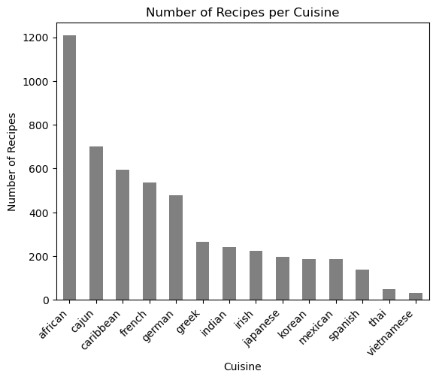
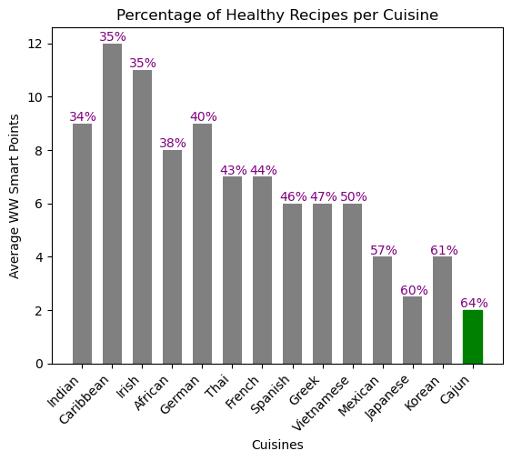
Data Analysis and Visualisation
Cuisines: Which cuisine has the healthiest recipes?

Slide 14
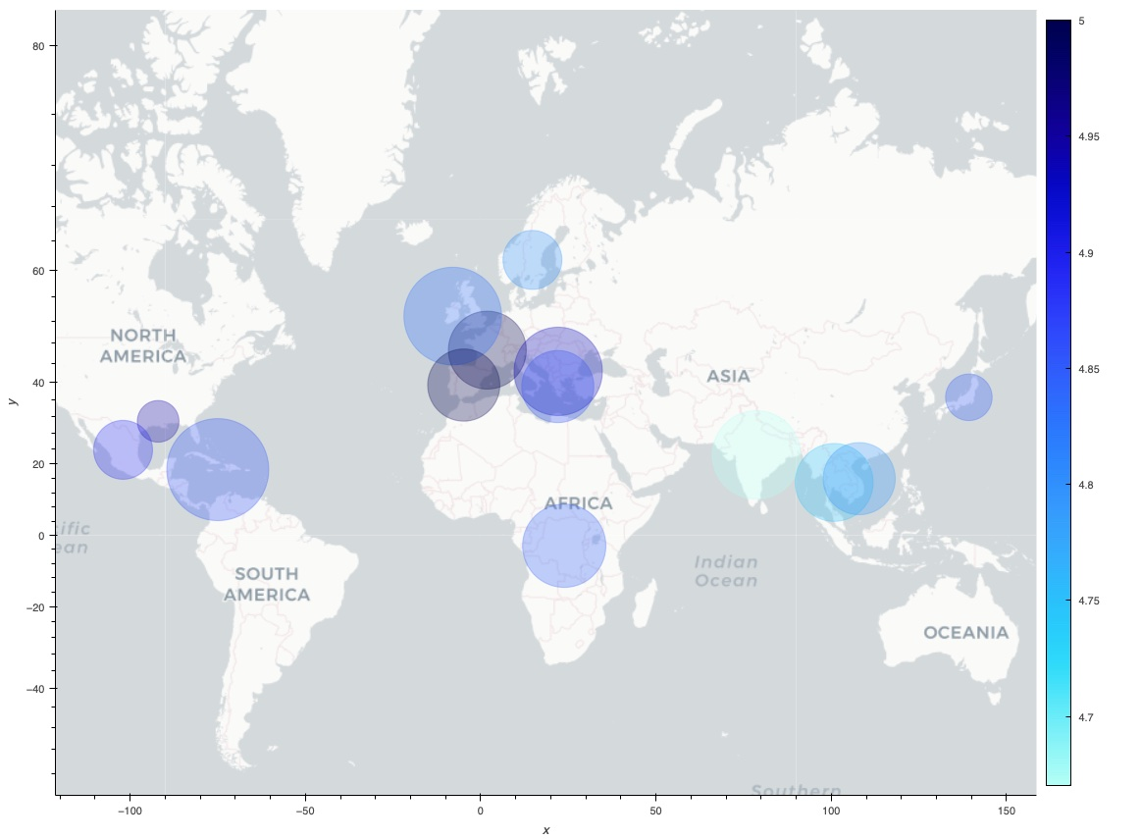
Data Analysis and Visualisation
Cuisines: Which cuisine has the healthiest recipes?

Slide 15

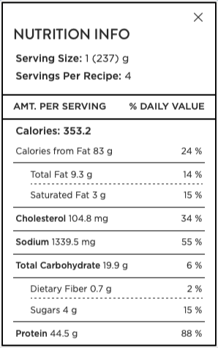
Cajun Fried Chicken Strips
Get the recipe!

